Slide 1

Notes:
Title — Elastic Multimodal Search

Slide 2
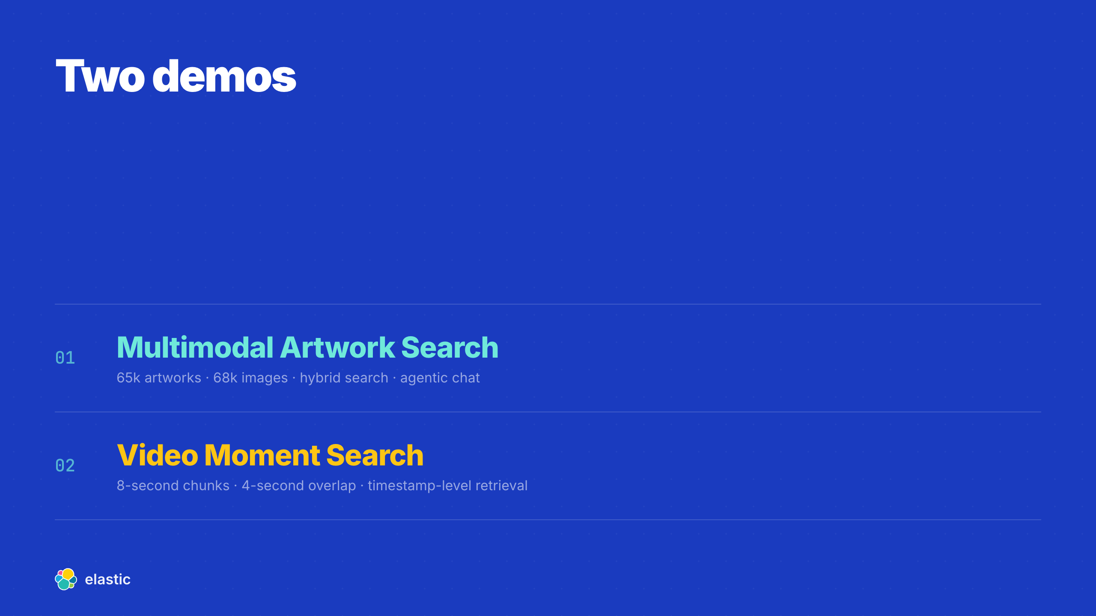
Notes:
Agenda

Slide 3

Notes:
Demo 1 Setup — What Multimodal Artwork Search Proves

Slide 4
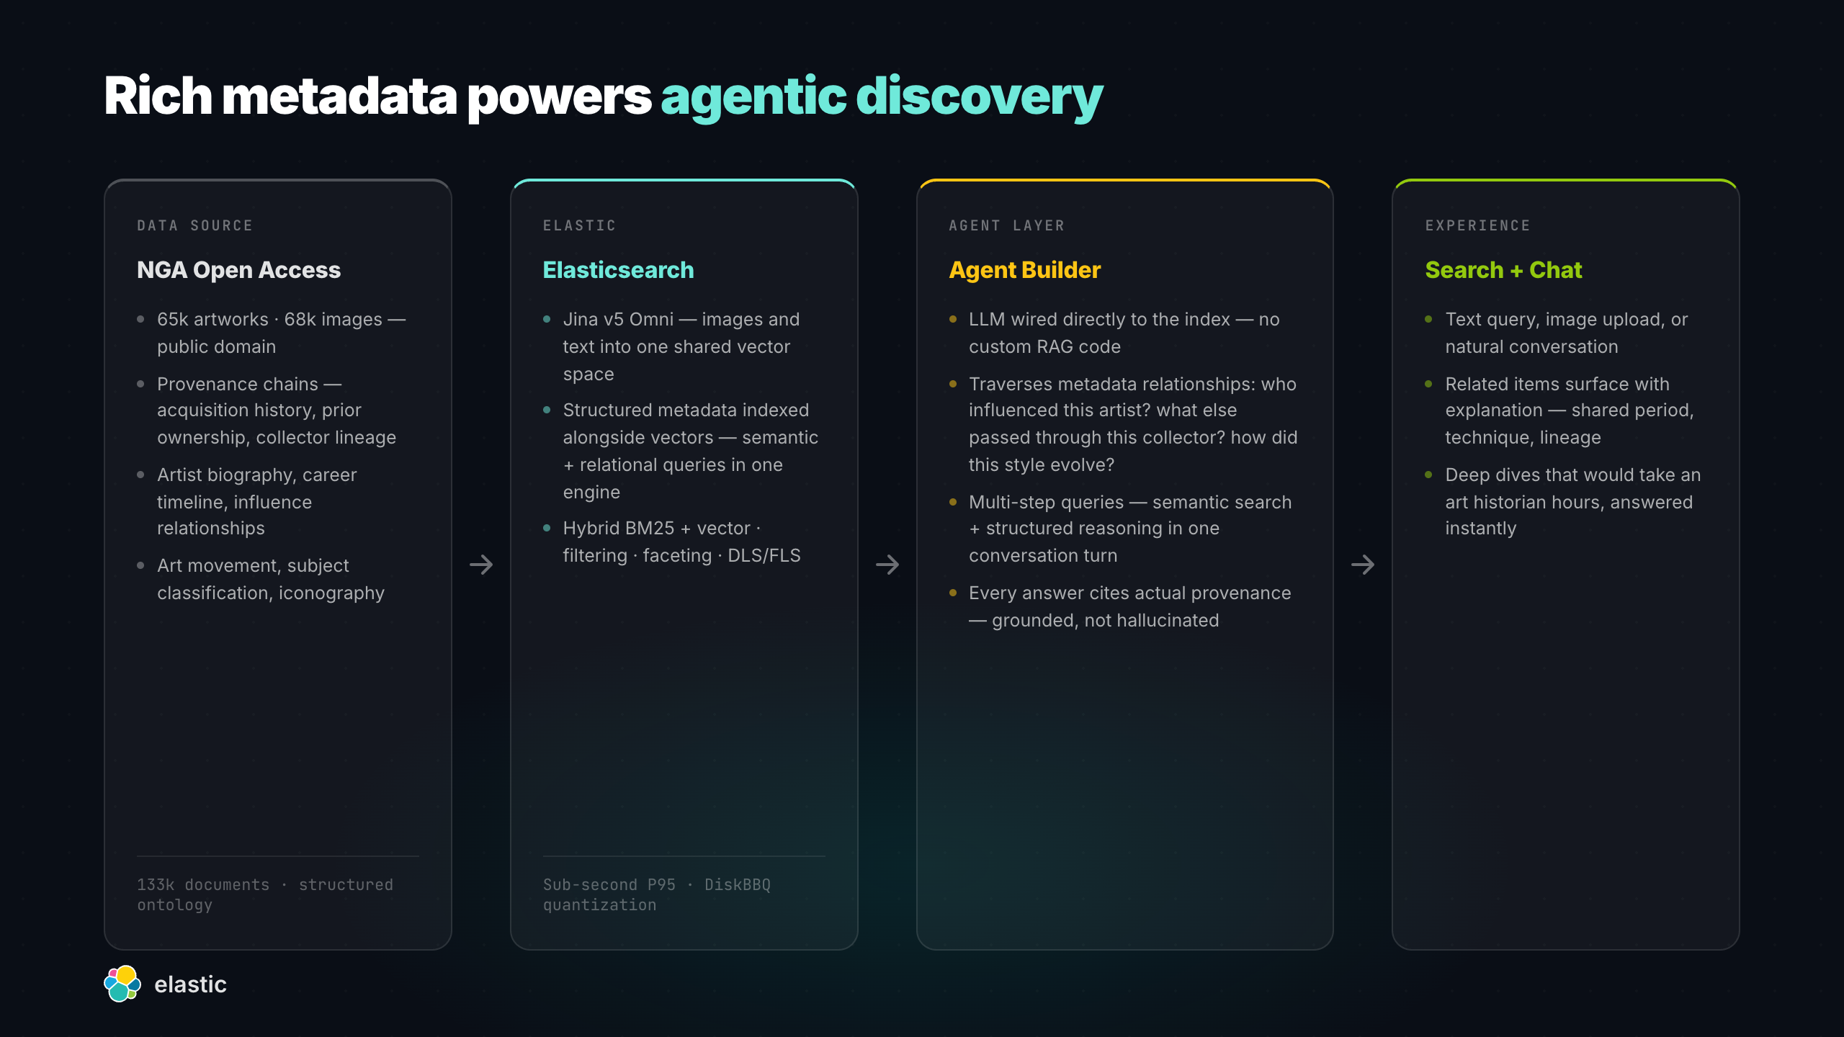
Notes:
Demo 1 Architecture — Artwork Search

Slide 5
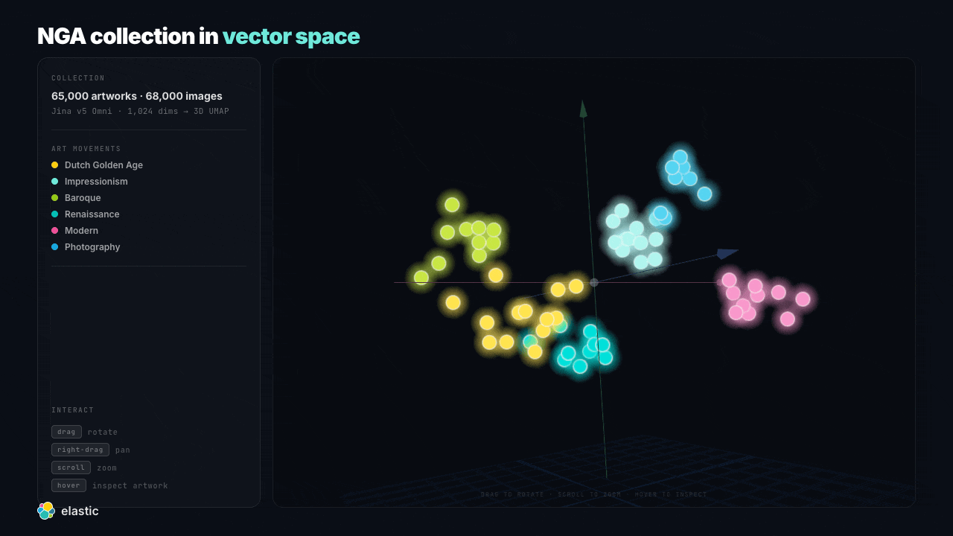
Notes:
Vector Space — One Shared Embedding Space — Vector space — rotating cloud

Slide 6
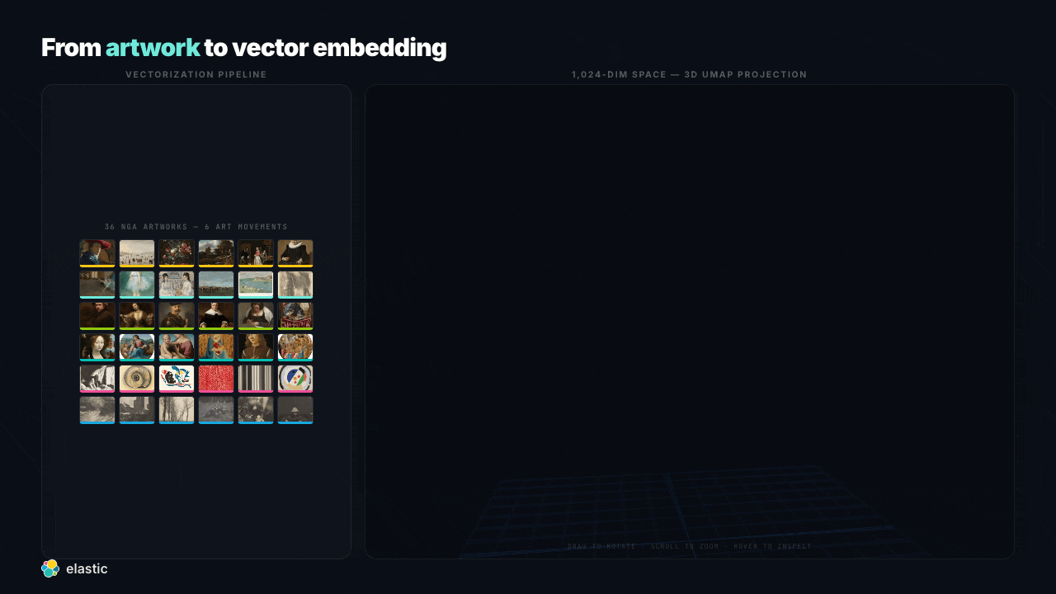
Notes:
Vectorize & Search — Interactive Pipeline — Vectorizing 36 artworks

Slide 7
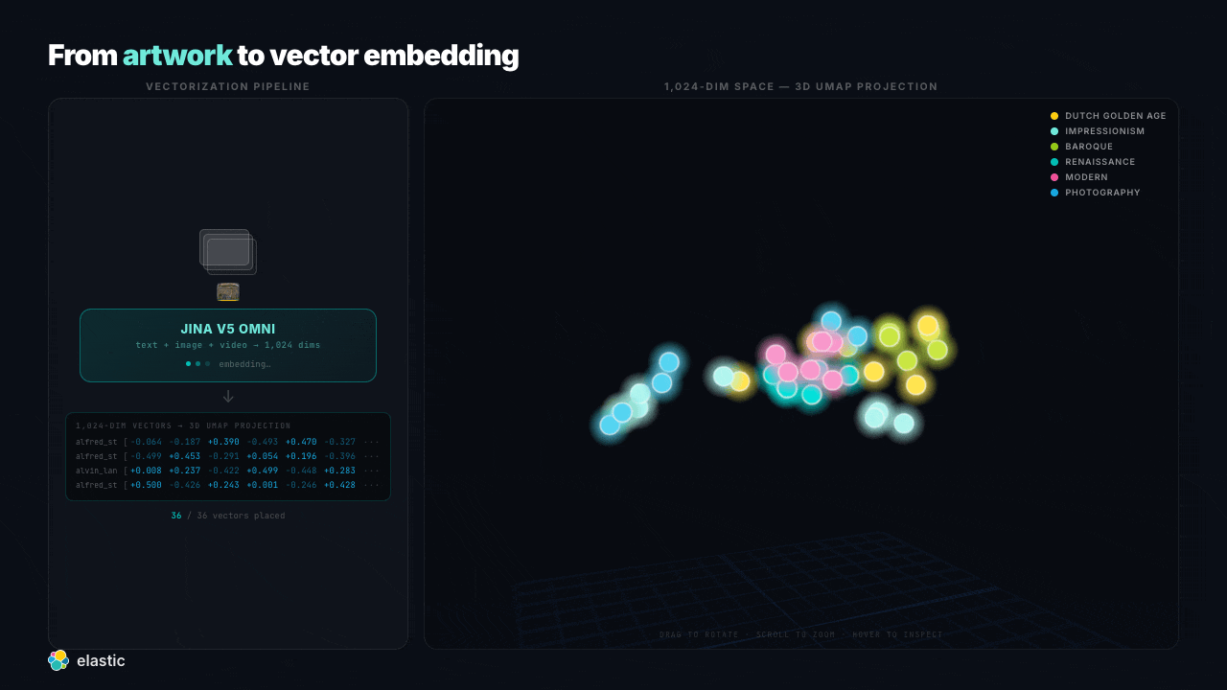
Notes:
Vectorize & Search — Interactive Pipeline — Search — nearest neighbours

Slide 8
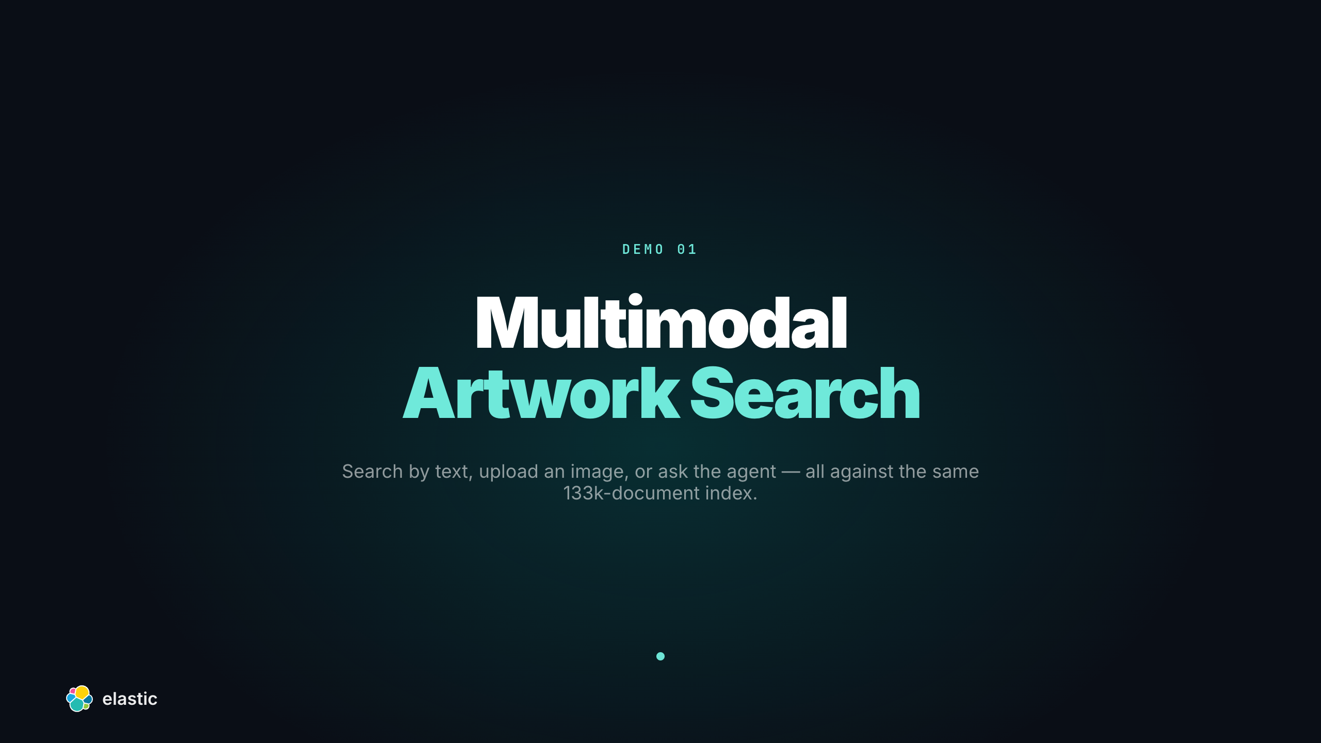
Notes:
Demo 1 — Multimodal Artwork Search

Slide 9
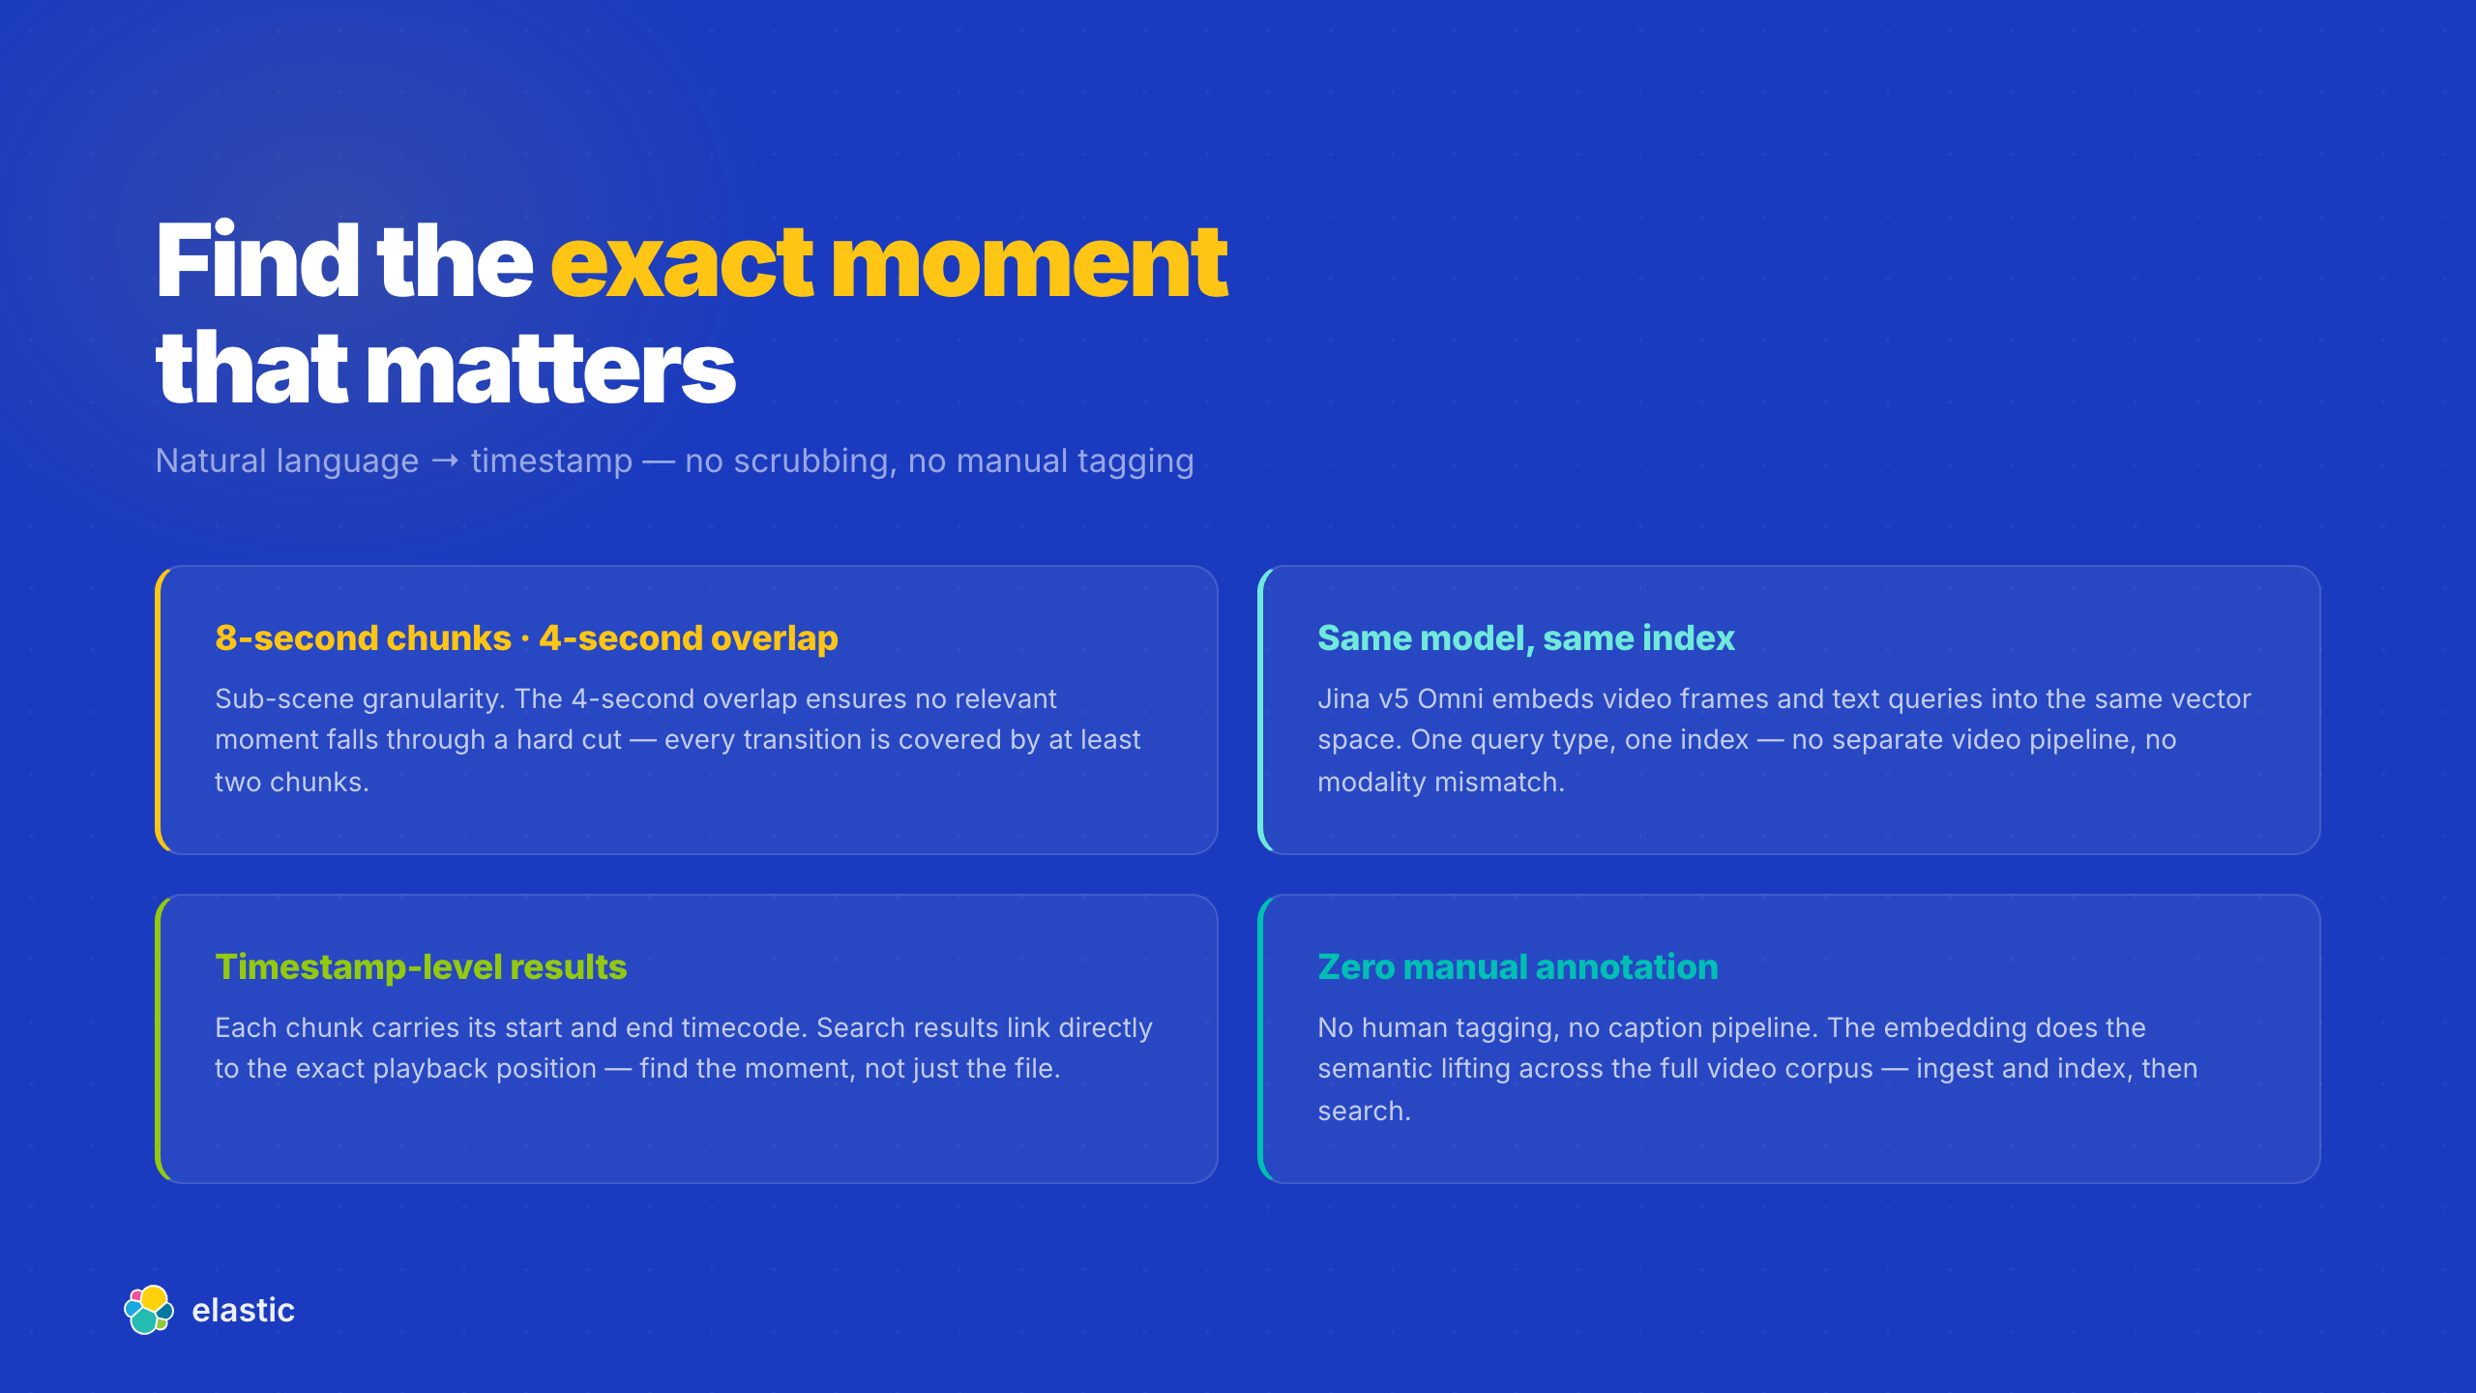
Notes:
Demo 2 Setup — What Video Moment Search Proves

Slide 10
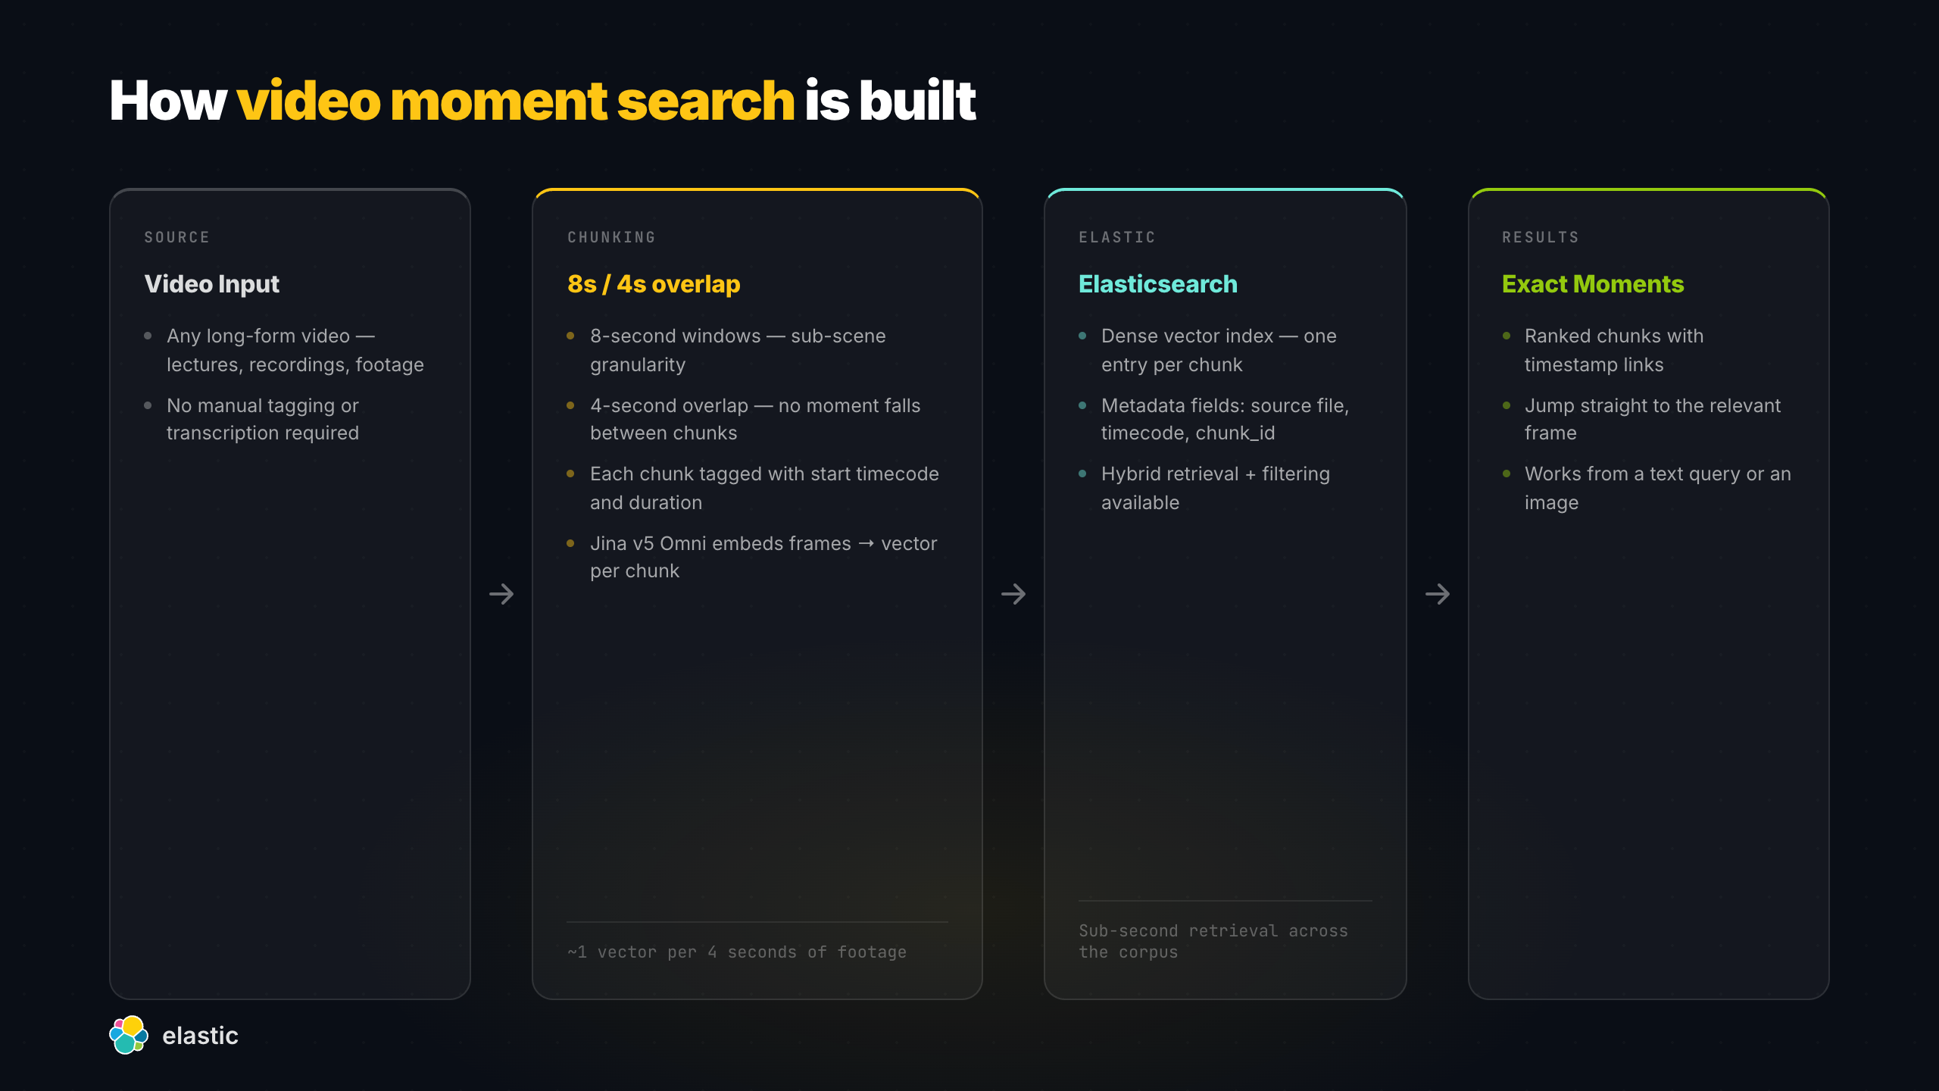
Notes:
Demo 2 Architecture — Video Search

Slide 11
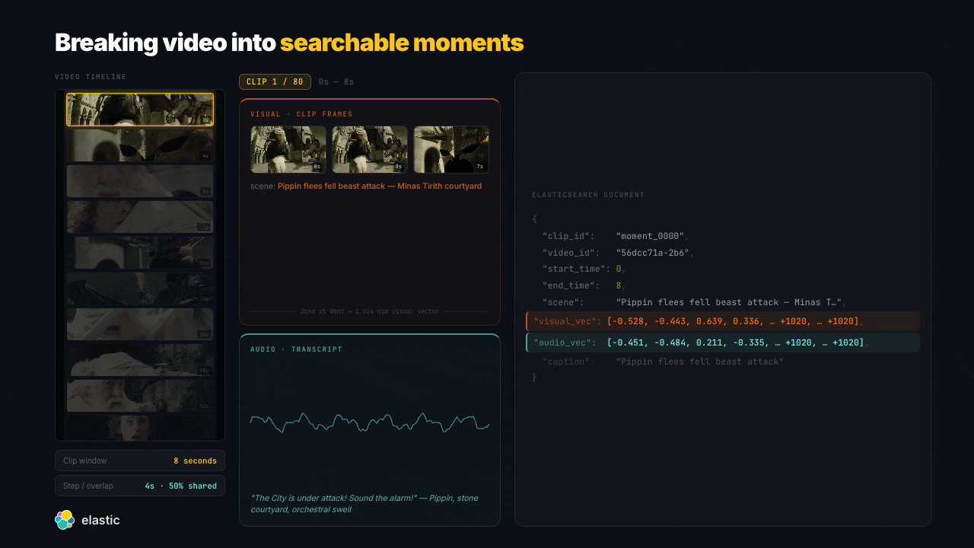
Notes:
Video Chunking — 8s Overlapping Moments — Video moment indexing — live

Slide 12

Notes:
Demo 2 — Video Moment Search

Slide 13
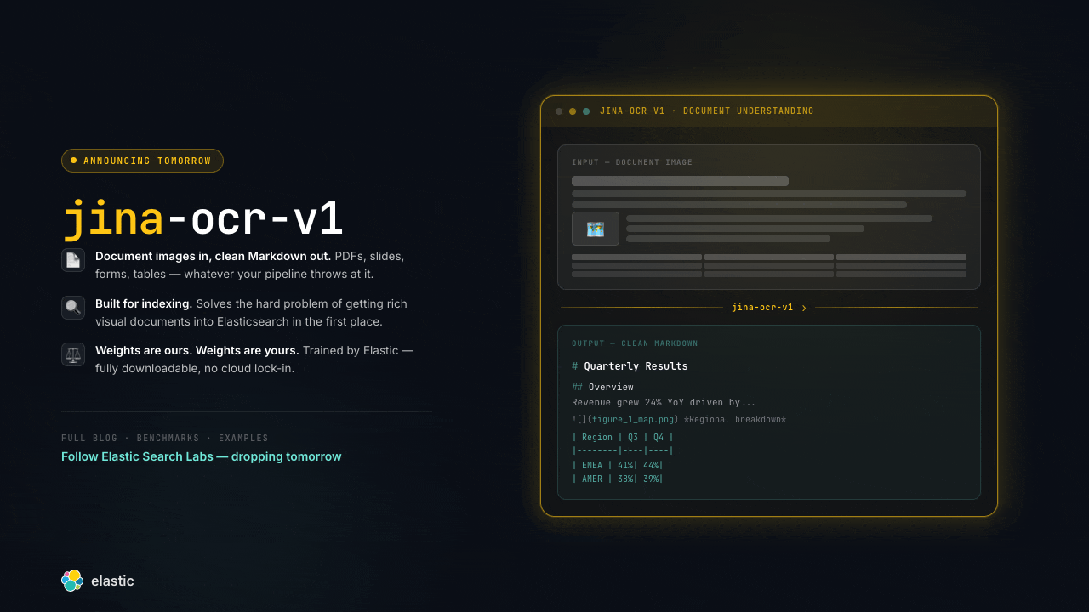
Notes:
Teaser — jina-ocr-v1 — jina-ocr-v1 — pulsing reveal

